Slide 1
Module 1
Introduction to Management

Slide 2
Introduction
Management is a comprehensive function of Planning, Organising, Forecasting Coordinating, Leading, Controlling, Motivating the efforts of others to achieve specific objectives.

Slide 3
Definitions
According to Harold Koontz “ Management is the art of getting things done through and with formally organized groups “.
According to Peter F. Drucker. “ A Multipurpose organ that manages a business and manages managers and manages workers and works “.
According to J.Lundy “ Management is what management does. It is the task of planning executing and controlling “.
According to Lawrence Appley “ Management is the development of people and not the direction of things“.

Slide 4
Objectives
1. Optimize resources
Management teams work to use resources effectively to provide the most output possible. This objective creates the ability to increase profits by reducing the ratio of resource costs to profits.
Management teams implement logistic strategies and procedures to identify and reduce processes that create waste and require extra resources.

Slide 5
Objectives
2. Increase efficiency
Increasing the efficiency of operations, production and services allows for greater production, sales and profits.
Management systems track the processes, duration and flow of the workplace to determine methods that provide more efficient outcomes.
Managers may work with other employees and department leaders to create and implement new processes and requirements.

Slide 6
Objectives
3. Maximize profits
Management teams aim to find the balance between maximizing profits and promoting a beneficial workplace for employees.
Maximizing profits includes working with various departments and leaders such as accountants, supervisors and executives to determine areas that require improvements and changes.
Managers can achieve maximum profit objectives by identifying unnecessary expenses and waste and creating new procedures for more efficient operations.

Slide 7
Objectives
4. Promote personal development
An effective management team prioritizes the growth and development of its employees.
Providing opportunities such as seminars, mentorship programs, training resources and internal promotions allows employees to develop new skills and advance their careers.
The personal development and growth of employees can also contribute to the growth, quality and efficiency of work produced and can help management achieve multiple objectives simultaneously.

Slide 8
Objectives
5. Maintain quality
Management teams handle the regulations, procedures and parameters for the production and distribution of products and services.
A primary objective of management includes maintaining the quality standards necessary for the organization.
The team collaborates with other departments, supervisors and employees to create, implement and maintain quality.

Slide 9
Objectives
6. Uphold workplace morale
The environment, attitudes and morale of an organization can affect the overall production and profits.
Positive morale among employees creates intrinsic motivation for employees to complete tasks and contribute greater effort.
Management teams work to uphold morale by implementing effective authority structures, creating incentive programs and responding to employee feedback.
Valuing employees and ensuring positive relations increases morale and motivates individuals to continue to grow.

Slide 10
Objectives
7. Reduce risk
Many management positions focus on forecasting and projecting results and changes.
One main objective for managers includes using planning and predictions to reduce opportunities for risks and losses.
Reducing risk factors such as safety issues, wasted resources and extra expenses can help increase profits and eliminate loss.

Slide 11
Objectives
8. Generate business strategies
Management teams often use higher-level critical thinking and abstract strategy to improve operations and profits.
The team collaborates with executives, leaders and stakeholders to generate, pitch and implement overall business strategies or frameworks.
Creating an effective and consistent business strategy can help identify and narrow objectives for all employees to reach a common goal.

Slide 12
Objectives
9. Coordinate workflows
The workflow and internal structure of an organization can influence productivity and efficiency.
Management teams may include or work with logistics, engineering and production professionals to develop logical and expedited workflows, internal structures and facility designs.
Managers may also utilize tools such as organization charts, flow diagrams and procedure audits to evaluate and communicate workflow operations.

Slide 13
Objectives
10. Identify talent
An organization's management aims to identify, acquire and maintain top candidates and employees.
Managers may work with recruiters to establish hiring requirements, evaluate candidates and create recruitment offers.
Identifying and gaining talented and qualified employees increases the knowledge, expertise and production of the organization as a whole.

Slide 14
Objectives
11. Ensure availability
Management teams work to handle, maintain and predict the availability of resources, goods and services.
To achieve this objective, managers may project and forecast the needs of the organization or public and monitor issues such as shortages.
Predicting and handling issues allows the management team to plan and implement changes to prevent production and distribution delays.

Slide 15
Functions of Managers
Planning
Planning can be defined as the process, by which, managers decide the mission and objectives of the firm. It involves taking necessary steps to achieve the desired objectives by establishing guidelines for future activities. Planning helps managers to decide on the activities to be performed with available resources

Slide 16
Functions of Managers
Organizing
Organizing is the process of assigning and allocating tasks, authority, and resources to enable a firm to achieve its organizational objectives.
Staffing
Staffing involves manning the various positions in the organizational hierarchy. It involves activities such as identifying work-force requirements, recruitment, selection, and orientation of new employees.

Slide 17
Functions of Managers
Leading
Leading involves directing, influencing, and motivating employees towards achieving organizational objectives.
Controlling
Controlling can be defined as the continuous measurement and analysis of actual operations against the established industry standards developed during the planning process and corrections of deviations, if any.
The main elements of the control process include establishing the standards of performance, measuring the actual performance, comparing the actual performance with the industry standards developed during the planning process, and taking corrective action in case of deviation.

Slide 18
Nature of Management
To understand the nature of management, the following aspects of management need to be understood.
What is management/ is it a science?
Is it an art?
Is it multidisciplinary in nature/ is it a profession?

Slide 19
Management as Science
Frederick Winslow Taylor was the first manager-theorist to apply scientific principles in the field of management.
He attempted to find out the one best way of doing a task scientifically by observing, analyzing, and experimenting.
With his knowledge and experience at a steel manufacturing company, he came up with a few scientific principles in management.

Slide 20
Management as Science
Following the lead from F.W. Taylor, his followers, such as Frank and Lilian Gilberth, developed few more scientific ways in management.
Management is a social science and deals with human beings who are very complex, unlike inanimate things such as light or heat.

Slide 21
Management as Art
Under science, one learns the 'why' of a phenomenon, but under art, one learns the 'how of a phenomenon.
Art is mainly concerned with bringing the desired result with the application of skills.
To get things done.
Management discipline has both science and art components; it is both science and art.
Science and art are not mutually exclusive; actually, they are complementary to each other

Slide 22
Management as a Profession
According to McFarland, a profession should have specialized knowledge, principles, and skills.
A profession should have methods of acquiring training and experience. It should have formal ethical codes that guide the people practicing the profession.
A professional practicing a profession charges fee for the services he/she provides to their clients.
Unlike medicine or law, management is not a prerequisite for anyone to become managers.
Even though management has few features to become a profession as of now, management has not achieved the status of a profession.

Slide 23
Management Vs Administration
Management refers to the process of planning, organising, staffing, directing and controlling the activities of an organisation to achieve its goals efficiently and effectively.
It focuses on getting work done through people by motivating them, guiding their efforts and coordinating their activities. Management is action oriented and concerned with the execution of plans and policies.

Slide 24
Management Vs Administration
Managers operate at different levels such as top, middle and lower levels. At each level, management ensures that organisational objectives are translated into practical actions.
It deals with both human and non human resources and aims to maximise productivity while maintaining harmony within the organisation.

Slide 25
Management Vs Administration
Administration refers to the process of formulating policies, setting objectives and laying down the overall framework within which an organisation operates.
It is concerned with determining organisational goals and the broad strategies to achieve them. Administration is mainly focused on decision making at the top level and provides direction to management.

Slide 26
Management Vs Administration
Administrators represent the ownership or governing body of the organisation. Their role is more intellectual and strategic in nature.
They ensure that the organisation functions in accordance with its mission, vision, values and legal requirements.

Slide 27
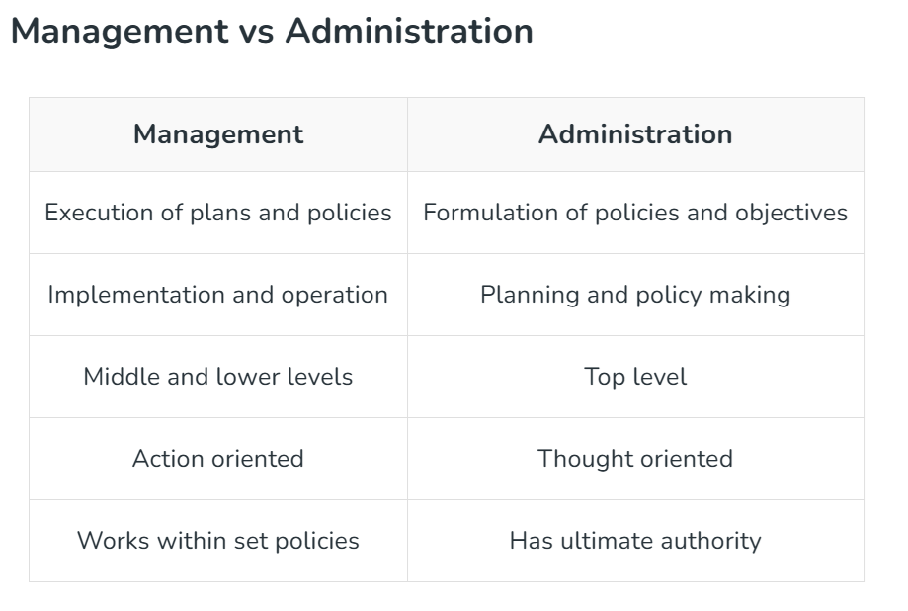
Management Vs Administration

Slide 28
Levels of Management
Top-level Managers The top-level management is responsible for the overall activities of an organization. It establishes plans and goals that influence the entire organization.
Top-level managers are few in number and occupy the posts of ‘Chief Executive Officer’, ‘Chairman’, ‘President’, ‘Vice-President’, ‘Director’ etc.

Slide 29
Levels of Management
Middle-level Managers Middle-level managers are directly responsible for managing the performance of first-level managers.
They are responsible for the operational efficiency of various departments in an organization and review daily and weekly reports on production or sales.
They hold designations such as ‘Department Heads’, ‘Project Leader’, ‘Plant Manager’ and ‘Divisional Head.

Slide 30
Levels of Management
First-level Managers Managers at the first-level have the responsibility to manage the performance of the non-managerial personnel in an organization and ensure implementation of operational plans. They are also called Supervisors.
They are given different titles in different companies like ‘Foreman’, Clerical Supervisor’, ‘Technical Supervisor’, etc.

Slide 31
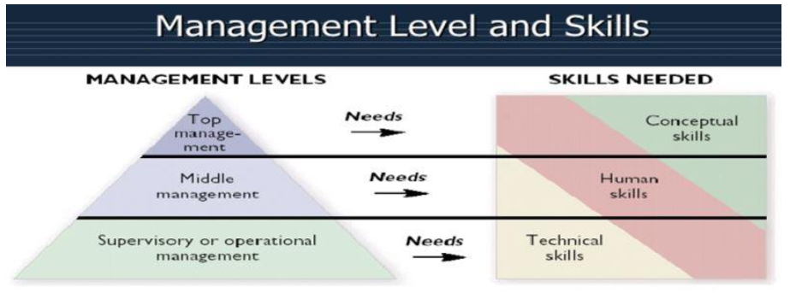
Levels of Management

Slide 32
Evolution of Management Thought
Classical Approach
Administrative Functional or Process Approach (Henri Fayol)
Scientific Management (F. W. Taylor)
Bureaucratic Approach (Max Weber)
Neo-Classical Approach
Hawthrone Experiments
Behavioural Science Approach
Social System Approach
Contingency Approach

Slide 33
Classical Approach
Beginning of systematic study of the organization.
Emphasis on:
Planning of work
Technical requirements of the organization
Principles of management
Assumptions of rational and logical behavior
It ignored the impact of external environment on the working of the organization.
Thus, it treated organizations as closed systems.

Slide 34
Classical Approach Administrative Functional or Process Approach (Henri Fayol)
An organization grew and became more complex.
Need to systematic understanding of overall management process.
Managers are concerned about management of organization rather than increasing the efficiency of individual jobs.
Henry Fayol- Father of General Management

Slide 35
Henri Fayol’s 14 Principles of Management
Division of Work: Specialization increases output by making employees more efficient.
Authority and Responsibility: Managers must have the authority to give orders, balanced with responsibility for results.
Discipline: Employees must obey and respect rules, as guided by effective leadership.
Unity of Command: Each employee should receive orders from only one superior to avoid conflict.

Slide 36
Henri Fayol’s 14 Principles of Management
Unity of Direction: Activities with the same objective should be directed by one manager using one plan.
Subordination of Individual Interest: The interests of the organization take precedence over personal interests.
Remuneration: Fair pay is essential to motivate employees.
Centralization: A proper balance between centralized authority and delegation (decentralization) is required.
Scalar Chain: A clear, direct line of authority from top management to the lowest ranks.

Slide 37
Henri Fayol’s 14 Principles of Management
Order: Both material and social resources should be in the right place at the right time.
Equity: Managers should treat employees with kindness and fairness.
Stability of Tenure: High employee turnover should be avoided to ensure efficiency and stability.
Initiative: Employees should be encouraged to create and carry out plans.
Esprit de Corps: Promoting team spirit and harmony to build unity within the organization.

Slide 38
Classical Approach Scientific Management (F. W. Taylor)
Scientific management means knowing exactly what you want men to do and seeing that they do it in best and cheapest way.
It means conducting business activities according to standardized tools, methods and trained personnel in order to increase the output, improve its quality and reduce costs and waste.
Frederick Winslow Taylor– Father of Scientific Management

Slide 39
Principles of Scientific Management
1) Science, not rule of thumb
2) Harmony, not discord
3) Cooperation, not individualism
4) Development of workers to their greatest efficiency and Prosperity

Slide 40
Classical Approach Bureaucratic Approach (Max Weber)
It is a theory of organization emphasizing a strict, rational hierarchy, specialized roles, and impersonal, rule-based management to achieve maximum efficiency and predictability.
Principles:
Division of work
Rules and Regulations
Hierarchy of authority
Technical competence
Record keeping
Impersonal relations

Slide 41
Neo-Classical approach (Hawthorne Experiments-Elton Mayo)
The classical writers neglected the human relations aspect.
It focused on human aspect of the industry.
Inter-personal relations and informal groups at the workplace.
George Elton Mayo – Father of Human relations approach

Slide 42
Hawthorne Experiments
These experiments were conducted during 1920’s at a plant of the Western Electric Company.
The plant was located at Hawthorne near Chicago in the USA.
The experiments were conducted in 4 phases.

Slide 43

Hawthorne Experiments-Phase 1
Phase 1 – Illumination Experiment (1924-1927)
Tested lighting levels; productivity rose regardless of lighting changes.

Slide 44
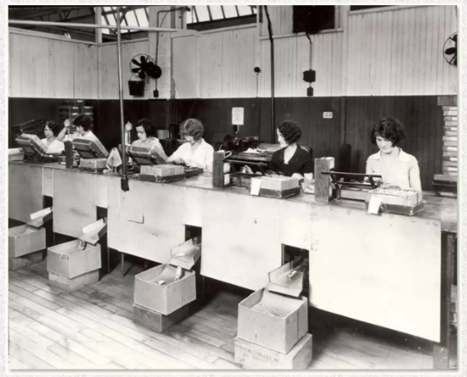
Hawthorne Experiments-Phase 2
Phase 2 – Relay Assembly Test Room (1927-1929)
Shorter working hours
Rest pauses
Improved physical conditions
Friendly and informal supervision
Free social interaction among group members
Morale and productivity increased

Slide 45
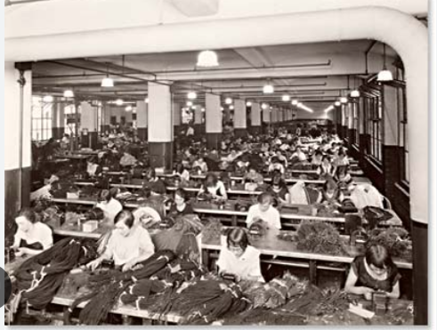
Hawthorne Experiments-Phase 3
Phase 3 – Mass Interview Program
Approximately 20,000 to 21,000 employees were interviewed between 1928 and 1930.
It was found that the opportunity to talk freely about things that are important to workers has a positive effect on their morale and productivity.

Slide 46
Hawthorne Experiments-Phase 4
Phase 4 – Bank Wiring Observation Room Study
A group of 14 male workers
The experiment showed that workers followed informal group norms and restricted their output, proving that social factors and group pressure influence productivity more than financial incentives.

Slide 47
Behavioural Science Approach
The human relations movement focused n interpersonal relations and overlooked the wider subject of organizational behaviour.
Organizational behaviour involves the study of attitudes, behaviour, and performance of individuals and groups in an organizational setting.

Slide 48
Behavioural Science Approach
Major conclusions of the contributions made by behaviouralists are as follows:
i. People do not dislike work. If they have been helped to establish objectives, they will want to achieve them.
ii. Their untapped potential remains unutilized.
iii. Managers’ basic job is to use untapped human potential in the organization.
iv. The manager should create a healthy environment wherein all persons can contribute to the best of their capacity..
v. Managers should provide opportunities for self-direction to their subordinates.
vi. Operating efficiency can be improved by expanding subordinate influence, self-direction, and self-control.
vii. Work satisfaction may improve as a ‘by-product’ of subordinates making full use of their potential.

Slide 49
Social System Approach
Organization is a system and its components are interrelated and interdependent.
The Social System Approach views an organization as a living, dynamic system comprising interrelated, interdependent people operating within a social environment.
It acknowledges that organizations are open systems that interact with their external environment.
This approach emphasizes the social relationships, values, norms, and communication patterns that affect the organization’s internal functions and performance.

Slide 50
Contingency Approach
The contingency approach is based on the belief that there is no one best way to tackle the problems of management.

Slide 51
Key Contemporary Management Issues
Technological Advancement & AI: Integrating AI, machine learning, and automation into operations while upskilling the workforce is a major challenge and opportunity.
Digital Transformation & Cybersecurity: Shifting to digital, managing legacy systems, and protecting data from evolving threats.
Hybrid Work & Workforce Dynamics: Managing remote/hybrid teams, maintaining company culture, and ensuring work-life balance.
Sustainability & ESG: Addressing environmental concerns, ethical supply chains, and Corporate Social Responsibility (CSR).

Slide 52
Key Contemporary Management Issues
Diversity, Equity, and Inclusion (DEI): Navigating cultural, ethnic, and social differences in a global workforce to enhance innovation.
Change Management & Agility: Quickly adapting to economic, political, and market instability.
Ethical Leadership & Governance: Shifting to stakeholder-centric, transparent, and ethical business practices.
Talent Management & Retention: Finding and retaining skilled manpower in a competitive market. Managers must adopt flexible, strategic, and human-centric approaches to turn these challenges into opportunities for growth.

